Slide 1
"What can we learn from Happiness research? Consequences for policy, companies and each of us“ Speech given in Teheran/Iran at Faculty of Management, Shahid Beheshti University, 4.5.2013. Faculty of Management, University of Teheran, 5.5.2013. Faculty of Economics, University of Teheran, 5.5.213. Prof. Dr. Karlheinz Ruckriegel www.ruckriegel.org

Slide 2
„THE PURSUIT OF HAPPINESS IS CHANGING THE WORLD“
“Berlin Speech” given by the former
Bundespräsident Horst Köhler in October 2007

Slide 4
In July 2011, the UN required that the states should pursue subjective wellbeing as an explicit goal of their political activity on Bhutan`s initiative.
“The reasoning is that since happiness is the ultimate desire of every individual, it must also be the purpose of development to create the enabling conditions for happiness.”
so the Gross National Happiness Commission of Bhutan.
Also the EU Parliament passed on a respective resolution in 2011.

Slide 5
UN Happiness Report

Slide 6
20. March 2013
International Day of Happiness
Back to 50ties of the last century

Slide 7
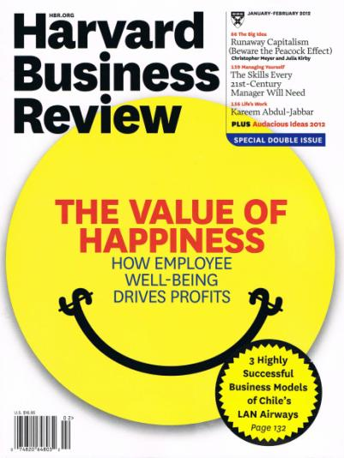

Slide 8
“Why write about happiness ….? Because emerging research from neuroscience, psychology, and economics make the link between a thriving workforce and better performance absolutely clear. Happiness can have an impact at both the company and the country level. And the movement to measure national well-being on factors other than GDP could be game changing: As we know, what gets measured gets managed. We’ve learned a lot about how to make people happy. We’d be stupid not to use that knowledge.”
Harvard Business Review, Jan./Feb. 2012, p. 77

Slide 9
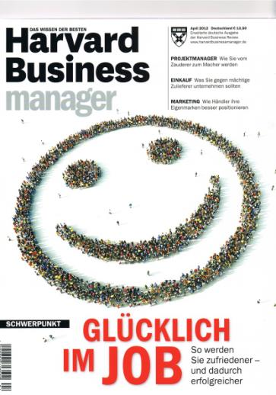

Slide 10
“We will certainly reach the point, when we will ask whether it is still useful and accurate to produce more goods and generate material wealth, or whether it is more meaningful to gain further leisure and free time, more relaxation and consciousness."
so Ludwig Erhard a former Bundeskanzler and one of the fathers of the concept of the “Soziale Marktwirtschaft” – the economic system in Germany - in his book „Wohlstand für Alle“ (Wealth for All) in 1957.
So the concept of the “Soziale Marktwirtschaft”“ went much beyond the purely economic and material sphere. It is based on the values of Christianism.

Slide 11
WHAT IS HAPPINESS?

Slide 12
Happiness is considered by most people to be the ultimate goal. Who realy wants to be unhappy in life?
It follows that economics is – or should be – about happiness.
What does this mean?
The question is: How to spend the time we have (24 hours a day) to feel happy.

Slide 13
Economics for a long time has taken income, or Gross National Product, as a suitable, though incomplete proxy for people`s wellfare.
Happiness research shows that reported subjective well-being is a far better measure of individual welfare.
Reported subjective well-being is the scientific term used in psychology for an individual`s evaluation of his or her experienced happiness with life.

Slide 14
More precisely:
SWB refers to people`s evaluation of their lives – evaluations that are both affective and cognitive.
SWB consists of three parts:
Positive emotions,
negative emotions and
satisfaction with life.

Slide 15
“Happiness is the experience of frequent, mildy pleasant emotions, the relative absence of unpleasant feelings, and a general feeling of satisfaction with one`s life.”
Biswas-Diener, R., Dean, B., Positive Psychology Coaching – Putting the Science of Happiness to Work for Your Clients, Hoboken (New Jersey) 2007, p. 41.

Slide 16
“The happiness of mankind … seems to have been the original purpose intended by the Author of nature, when he brought them into existence.”
Smith, A.: The Theory of moral Sentiments, 1759

Slide 17
EFFECTS OF HAPPINESS

Slide 18
Happy people live longer, stay married longer, make more money, receive better evaluations from work supervisors, take fewer sick days, are more altruistic and more creative.
Happiness is functional. Individuals, families, organizations, and societies need happy individuals to flourish. Happy people are more likely to be curious and explore, to take risks and to seek new social contacts.
Biswas-Diener, R., Dean, B., Positive Psychology Coaching – Putting the Science of Happiness to Work for Your Clients, Hoboken (New Jersey) 2007, p. 31 and p. 41.

Slide 19
HOW IS HAPPINESS MEASURED?

Slide 20
Surveys: Global Evaluation of Individual Life Satisfaction by asking a representative sample of individuals about their overall happiness or satisfaction with the life they lead.
For example: World Values Surveys, Gallup World Poll, Eurobarometer Surveys, German Socio Oeconomic Panel (GSOP)
GSOP: Life satisfaction is assessed on a scale from 0 (very, very dissatisfied) to 10 (very, very satisfied).

Slide 23
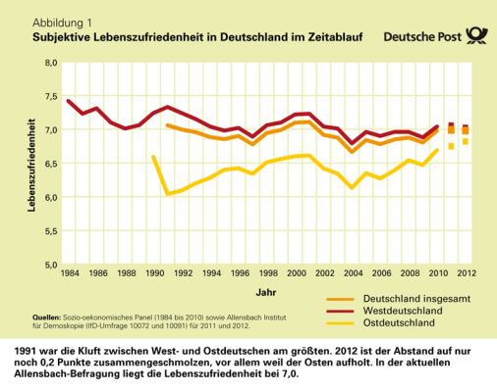

Slide 24
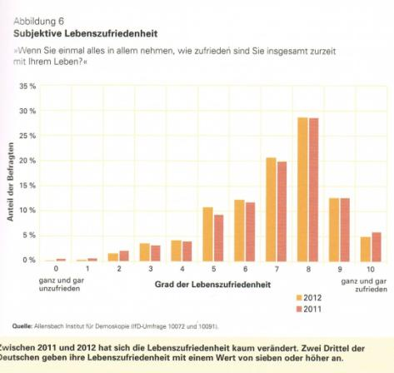

Slide 25
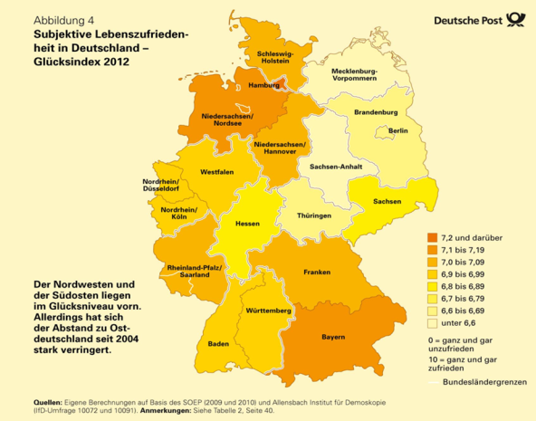

Slide 26
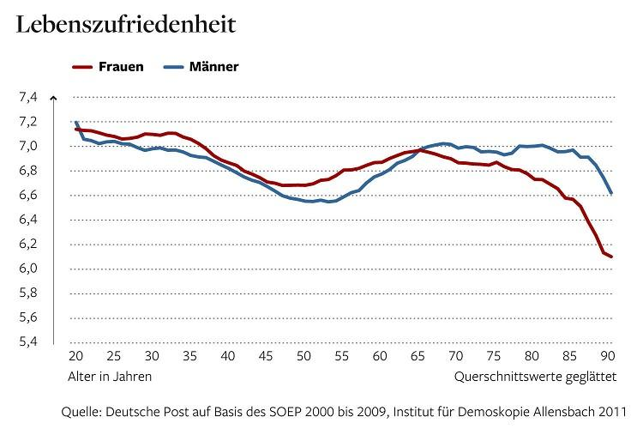

Slide 27
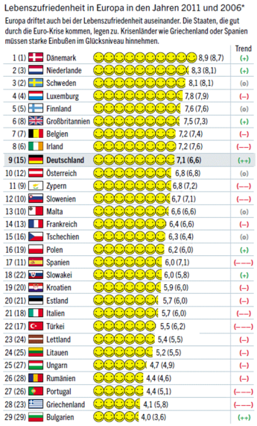

Slide 28
IF YOU`RE SO RICH, WHY AREN`T YOU SO HAPPY?

Slide 29
„It does appear that, despite the massive increase in wealth, incomes and access to material goods and services, our perception of happiness has not really changed that much. Increased wealth has not brought with it similar increase in happiness.”
N. Gregory Mankiw, Mark P. Taylor, Economics, Second Edition 2011, S. 501

Slide 30
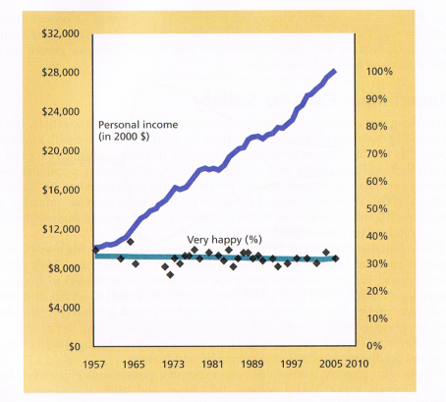
Quelle: David G. Myers, Social Psychology, 10. Auflage, New York 2010, S. 601

Slide 31
“For example, although today most Americans surveyed will tell you they are happy with their lives, the fraction of those who say that they are happy is not any higher than it was 40 years ago. …
Or, as your parents always said,
money doesn`t buy happiness.”
Ben S. Bernanke, 2010

Slide 32
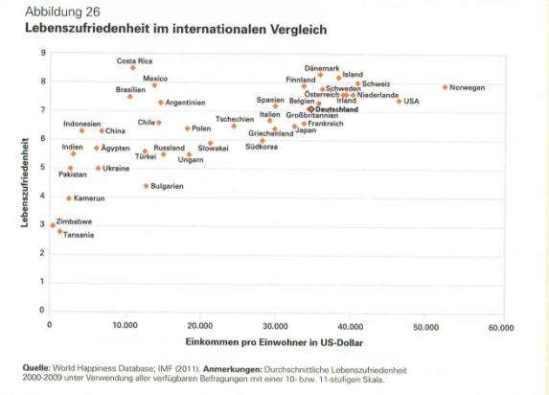
Quelle: Glücksatlas Deutschland 2011

Slide 33
WHAT ARE THE REASONS?
(Easterlin Paradoxon)

Slide 34
Adaptation
On the one hand, with the increase in income level, aspirations will also rise, therefore a person will not become more satisfied, this means the level of satisfaction stays the same (so-called hedonic treadmill).

Slide 35
Social Comparison
On the other hand - if the material existence is assured, less absolute income, but rather more relative income - that is, the personal income compared to others -– is decisive for the individual. A general rise in incomes for all only will increase the social norm, so that satisfaction does not rise, because all have more. With different changes in income: The sum of the ranks in an economy is fixed – if one wins, another must lose - a zero sum game.

Slide 36
„Since the consumption benefit approaches zero as income rises, happiness profiles over time in developed countries are flat.” Andrew Clark at al. in survey about research in Happiness Research
(Journal of Economic Literature, March 2008)

Slide 37
“It is ironic that as rich nations have increased their wealth, people have not on average become a lot happier.”
Ed Diener und Robert Biswas-Diener (2008, S. 105).

Slide 38
“If it turns out to be true that rising incomes have failed to make Americas happier, as much of the recent research suggests, what is the point of working such long hours and risking environmental disasters in order to keep on doubling and redoubling our Gross Domestic Product?”
Derek Bok, former long-term President of Harvard University, 2010

Slide 39
Factors Contributing to Happiness

Slide 40
Happiness research has identified the factors contributing to happiness:
family relationships and social environment,
health,
job satisfaction and engagement,
financial situation (income) and (financial) security,
personal freedom,
life philosophy (attitude towards life and spirituality/religion).

Slide 41
Political consequences

Slide 42
„Another key message, and unifying theme of the report is that the time is ripe for our measurement system to shift emphasis from measuring economic production to measuring people`s well-being. And measures of well-being should be put in a context of sustainability.“
Joseph E. Stiglitz, Amartya Sen, Jean-Paul Fitoussi,
MIS-Measuring our Lives, New York, 2010, S. 10

Slide 43
“Over the past 50 years, the OECD has developed a rich set of recommendations on policies that can best support economic growth. The task that we face today is to develop an equally rich menu of recommendations on policies to support societal progress: better policies for better lives.”
OECD, Better Life Initiative, Mai 2011

Slide 44
„But what ultimately matters is the well-being of citizens“
OECD: HOW`S LIFE - Measuring Well-Being, Oktober 2011, S. 16

Slide 47
“Subjective well-being data can provide an important complement to other indicators already used for monitoring and benchmarking countries performance, for guiding people’s choices, and for designing and delivering policies. Measures of subjective well-being show meaningful associations with a range of life circumstances, including the other dimensions of well-being explored in the Better Life Initiative.”
OECD Guidelines on Measuring Subjective Well-being, 2013

Slide 48
1972
(Emile v. Lennep, OECD)
(Sicco L. Mansholt, Europ. Kom.)
Notes:
Die Diskussion über den richtigen Indikator für die Wirtschaftspolitik wurde schon in den 70er Jahren des letzten Jahrhunderts geführt. Der Präsident der Europäischen Kommission war für einen Glücksindikator, für einen „Gross National Happiness Index“, der Generalsekretär der OECD etwa dagegen. Allerdings gab es ein kleines Land zwischen China und Indien im Himalaya, das seinen eigenen Weg zum Glück ging.

Slide 49
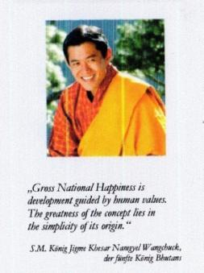

Slide 50
WHAT CAN WE – EACH OF US - DO TO IMPROVE HAPPINESS? WHAT CAN WE LEARN FROM POSITIVE PSYCHOLOGY?

Slide 53
1. Practicing Gratitude and Positive Thinking
a) Expressing Gratitude
Gratitude is the opposite of negative feelings. ..
b) Cultivating Optimism
c) Avoiding Overthinking and Social Comparison
2. Investing in Social Connections
a) Practicing Acts of Kindness
b) Nurturing Social Relationships
By the way working on a deep loving relationship is the most important happiness maker.

Slide 54
3. Managing Stress, Hardship and Trauma
a) Developing Strategies for Coping
-- Problem-focused coping
Concentrate your effort on doing something about it, make a plan of action
-- Emotion-focused coping
b) Learning to forgive
You do this for yourself and not for the person who has hurt you. Clinging to bitterness or hate harms you more than the object of your hatred.

Slide 55
4. Living in the Present
a) Increasing your flow Experience
Flow Experience: you are totally absorbed, you completely lose track of time. Flow is a state of intense absorption and involvement of the present.
b) Savoring Life`s Joys
5. Care of your Body and your Soal
a) Practicing religion and spirituality.
b) Taking care of your body

Slide 56
„When you are working, studying, or pursuing a hobby, do you sometimes become so engrossed in what you are doing that you totally lose track of time? That feeling is called flow. If you never have that feeling, you should find some new activities – whether work or hobbies.” Ben Bernanke, 2010

Slide 57
Happiness Research – Implications for companies

Slide 58
„Whether you manage a few people, lead a large group, or run an entire organiziation, you are already in the business of managing employee wellbeing.
The research on this topic is quite clear: Your workforce`s wellbeing has a direct impact on your organization`s bottom line.“
Tom Rath, Jim Harter, The Economics of Wellbeing, New York (Gallup) 2010, S. 1

Slide 59
“Happy employees produce more than unhappy ones over the long term. They routinely show up at work, they’re less likely to quit, they go above and beyond the call of duty, and they attract people who are just as committed to the job. Moreover, they’re not sprinters; they’re more like marathon runners, in it for the long haul.”
Gretchen Spreitzer, Christine Porath, Creating Sustainable Performance, in: Harvard Business Review, January-February 2012, p. 93.

Slide 60
Situation in Germany

Slide 61
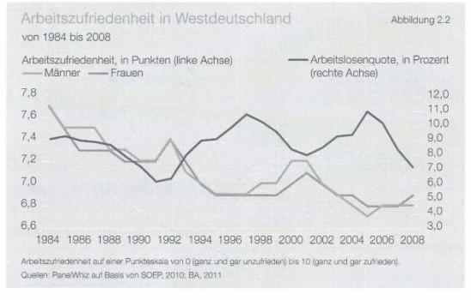
Quelle: Berta van Schoor / Susanne Seyda, Die individuelle Perspektive: Die Zufriedenheit von Männern und Frauen mit Familie und Beruf, in: Wie viel Familie verträgt die moderne Gesellschaft? hrsg. vom Roman-Herzog-Institut 2011, S. 30
Notes:
Betrachtet man die Entwicklung der Arbeitszufriedenheit gemäß dem Sozio-oekonomischen Panel, so zeigt sich eine dramatische Entwicklung.
Die Werte für die Arbeitszufriedenheit sind von 7,8 auf 6,8 von 1984 bis 2008 abgestürzt.

Slide 62
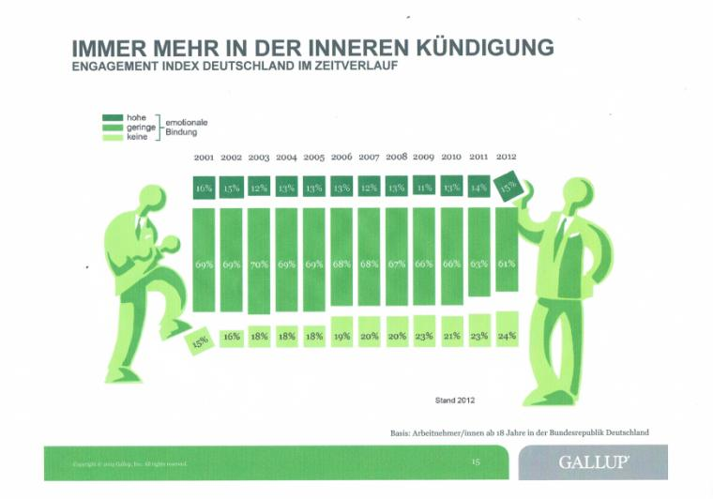

Slide 63
Burnout is a psychological term for the experience of long-term exhaustion and diminished interest.
Treatment in case of high levels of burnout: 6-8 weeks in hospital; after hospital: 1 – 2 years therapy
High level burnout in big German companies:
employees case of b.o.
(in Germany) (estimated)
Allianz 40,837 2,400-3,400
Deutsche Bank 24,800 1,400-1,900
BMW 73,324 2,200-5,200
Daimler 167,694 4,900-11,400
Siemens 116,000 3,800-9,000
VW 224,851 3,400-6,300

Slide 64
The philosophy is simple: When the staff is happy, the boss tends to be happy, too. Ultimately, only happy people will be committed and motivated.

Slide 65
To start with: Causes of stress (negative influence on subjective wellbeing)
Cognitive overload: having too much to do.
Role conflict: being unsure of one`s job description.
Ambiguity: not knowing what one is supposed to be doing.
Discrimination: job ceilings that prevent one from rising in the ranks.
Not getting promoted, because of sexism, ageism, or other prejudices.

Slide 66
6. Poor social networks preventing outlets to process job stress.
7. Lack of control over what one is doing and when it is done.
8. Multiple roles that need to be balanced.
9. Not being challenged enough.
Gurung, Health Psychology, 2010, S. 132

Slide 67
WHAT SHOULD (BETTER MUST!!!) COMPANIES DO? or How to get good managers

Slide 68
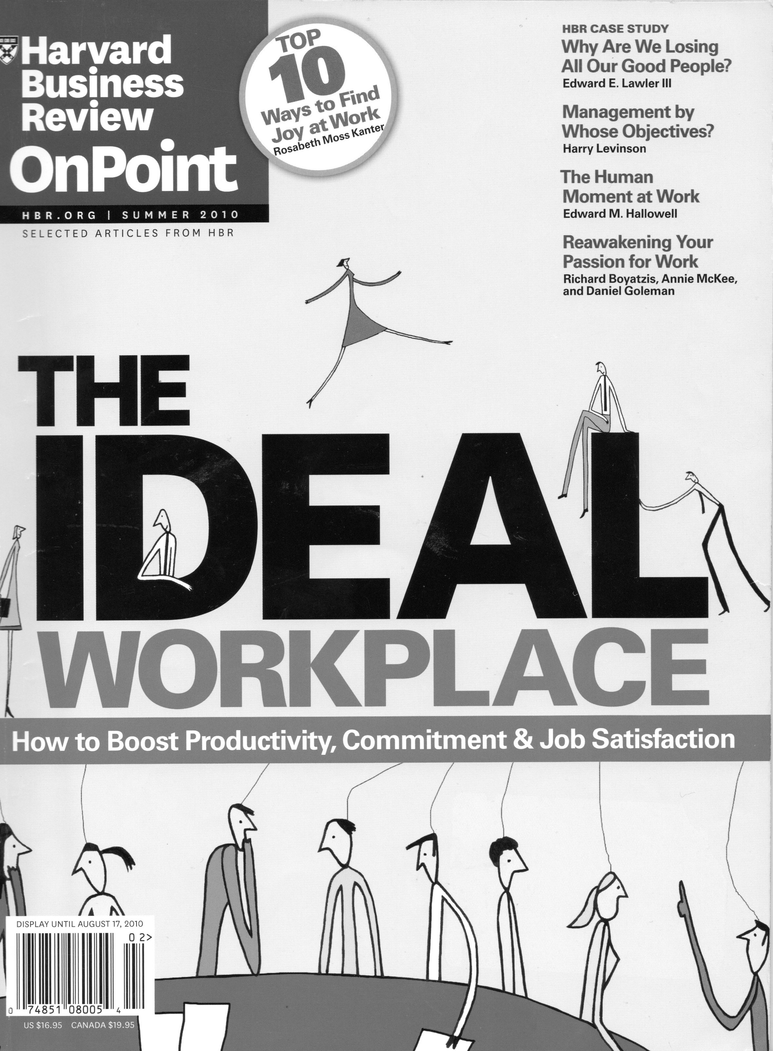

Slide 69
What is important?
How should managers behave to be successful which means to motivate employees by satisfying their need for achievement, equity and camaraderie?
Or how should managers behave to make their employees „happy“ ?

Slide 70
What is to do – an overview

Slide 71
Achievement
Instill an inspiring purpose (making clear what the contribution of the company for the society (people)) is.
2. Provide recognition (employees want to be respected).
3. Be an expediter for employees (go away from a command and –controll style and help people to get their work done).
4. Give employees feedback and coach them for improvement.

Slide 72
Equity
5. Communicate fully and treat employees fairly (paying, job security, …)
6. Deal decisively with poor performance
Camaraderie
7. Promote teamwork

Slide 73
Pulling It All Together
8. Listen and invite (Employees are a rich source of information of how to do a job well. So use an participative style. Participative managers continually express their interest in employees`ideas).
There is a lot to do – but it pays to have happy employees!

Slide 74
What is to do: in a nutshell:
(Gretchen Spreitzer, Christine Porath, Creating Sustainable Performance, in: Harvard Business Review, January-February 2012, p. 93-98)

Slide 75
“We think of a thriving workforce as one in which employees are not just satisfied and productive but also engaged in creating the future—the company’s and their own. Thriving employees have a bit of an edge—they are highly energized—but they know how to avoid burnout.”

Slide 76
Providing Decision-Making Discretion
Employees at every level are energized by the ability to make decisions that affect their work. Empowering them in this way gives them a greater sense of control, more say in how things get done, and more opportunities for learning.
Sharing Information
Doing your job in an information vacuum is tedious and uninspiring; there’s no reason to look for innovative solutions if you can’t see the larger impact. People can contribute more effectively when they understand how their work fits with the organization’s mission and strategy

Slide 77
Minimizing Incivility
The costs of incivility are great. … Most people have experienced rude behavior at work. … Incivility prevents people from thriving. … Faced with incivility, employees are likely to narrow their focus to avoid risks—and lose opportunities to learn in the process.
Offering Performance Feedback
Feedback creates opportunities for learning and the energy so critical for a culture of thriving. By resolving feelings of uncertainty, feedback keeps people’s work-related activities focused on personal and organizational goals. The quicker and more direct the feedback, the more useful it is.

Slide 78
What is to do – to start with:
Getting known the problems with using a professional questionnaire
Discussing the results with the management
Implementing concrete steps to improve the situation

Slide 79
“We’ve learned a lot about how to make people happy.
We’d be stupid not to use that knowledge.”
Harvard Business Review, Jan./Feb. 2012, p. 77

Slide 80
Literature
Steve R. Baumgardner, Marie K. Crothers, Positive Psychology, Pearson 2010;
Ben Bernanke, “The economics of Happiness”, Speech given at the University of South Carolina, 8. May 2010;
Ed Diener, Robert Biswas-Diener, Happiness – Unlocking the Mysteries of Psychological Wealth, Malden USA 2008;
Robert Biswas-Diener, Ben Dean, Positive Psychology Coaching – Putting the Science of Happiness to Work for Your Clients, John Wiley and Sons 2007.
Derek Bok ,The Politics of Happiness – what government can learn from the new research on well-being, Princeton/ Oxford,. 2010.
Regan A.R. Gurung, Health Psychology A Cultural Approach, Wadsworth, Belmont (USA) 2010.
Harvard Business Review OnPoint, The IDEAL Workplace – How to Boost Productivity, Commitment & Job Satisfaction, Summer 2010;
Harvard Medical School, Positive Psychology – Harnessing the power of happiness, personal strength and mindfulness, Special Health Report 2009.

Slide 81
Sonja Lyubomirsky, The How of Happiness – A New Approach to Getting Life You Want, Penguin Books 2007;
Jessica Pryce-Jones, Happiness at Work – Maximizing your Psychological Capital for Success, Wiley-Blackwell 2010;
Karlheinz Ruckriegel, Happiness country analyses Germany, Report for the EU-Project „Key Competence Happiness – A New Theme in Adult Education and Consulting”, Juni 2010 (www.ruckriegel.org – Contributions to Happiness Research).
Karlheinz Ruckriegel , Happiness Research – Findings and implications for adult education, Report for the EU-Project „Key Competence Happiness – A New Theme in Adult Education and Consulting”, September 2010 (www.ruckriegel.org – Contributions to Happiness Research).
C.R. Snyder, Shane J. Lopez, Positive Psychology – The Scientific and Practical Exploration of Human Strengths, SAGE Publications 2007.
Gretchen Spreitzer, Christine Porath, Creating Sustainable Performance, in: Harvard Business Review, January-February 2012, p. 93-98

